Slide 1
Power of
Non-formal Education
LOTI project
Veli Iz - 19/04/2023

Slide 2
What is non-formal education?

Slide 3
NFE is based on active participation
Doing
Experiencing
A central part of the learning process is self-reflection
Activties/Exercises in NFE are of an experiential nature
With interactive input
→ a product of the facilitator and participants; they contribute with their experiences and knowledge

Slide 4
Some key characteristics of NFE
NFE is a planned learning process with educational objectives.
NFE activities are based on the needs of learners. NFE activities are open to the input of learners to the learning process and encourage making links to real life.
NFE is based on the voluntary participation of learners.
NFE is inclusive and accessible.
NFE methodologies are varied, participatory and learner-centred, they include a mix of individual and group learning and encourage people to learn from each other.
NFE can engage learners’ emotions, minds, and bodies (holistic).

Slide 5
Experiential Learning Cycle
“Learning is the process whereby knowledge is created through the transformation of experience” (David Kolb - 1984)

Slide 6
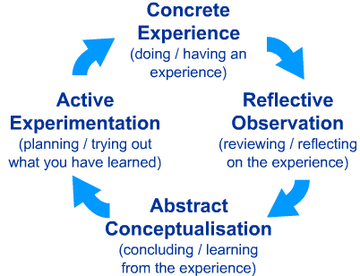
Experiential Learning Cycle

Slide 7
Experiential Learning Cycle
Concrete Experience – the learner encounters a concrete experience. This might be a new experience or situation, or a reinterpretation of existing experience in the light of new concepts.
Reflective Observation of the New Experience – the learner reflects on the new experience in the light of their existing knowledge. Of particular importance are any inconsistencies between experience and understanding.
Abstract Conceptualization – reflection gives rise to a new idea, or a modification of an existing abstract concept (the person has learned from their experience).
Active Experimentation – the newly created or modified concepts give rise to experimentation. The learner applies their idea(s) to the world around them to see what happens.

Slide 8
Debriefing ?

Slide 9
Debriefing
A productive flow of discussion to maximize the learning outcomes
structure in fact helps the facilitator, because it makes it easier for them and the group to follow the way the discussion is building up and crystalizing into learning points.

Slide 10
Debriefing
Reflection: discussion of their feelings, reactions, actions and thoughts during the experience itself;
Generalization: discussion of their associations with real life, general observations, general learning points. This discussion is based on the outcome of the reflection discussion;
Transfer: discussion of how they can take the learning points further, which ones are more suitable to them and how they can transfer them into their lives.
Ask adequate, good and relevant questions.
The questions should be strongly linked with the previous two aspects.
They have to lead the group towards deep insights.

Slide 11
Debriefing - Some general questions suggested for each phase:
Reflection
How did you feel?
What did you do?
How did you react?
Generalisation
What association do you make with this?
What general observations do you make?
What are the main important learning points?
Transfer
What can you take from this?
What will you apply in your realities?
What do you want to do differently next time?

